Slide 1
ReactJS
Raghu Prasad K S
9845547471

Slide 2
Introduction
Raghu Prasad – BE, MS
Total of 27 years of experience
7 years as a lecturer in Engineering College
20 Years into IT
Worked with companies like CISCO, CSC, ICICI, First Apex – NTT Data
urrently into Corporate training, consultancy and application development
Worked with corporates and public sector
Technologies – Java, Python, C#,.Net Framework DataSciences, Web Technologies, Java Script technologies (MEAN stack), IOT, Test Automation – Selenium, Jmeter,Block Chain

Slide 3
Course Outline
Introduction to FULLSTACK Web Application Development
Technologies related to FULLSTACK web application
Web application architecture

Slide 4
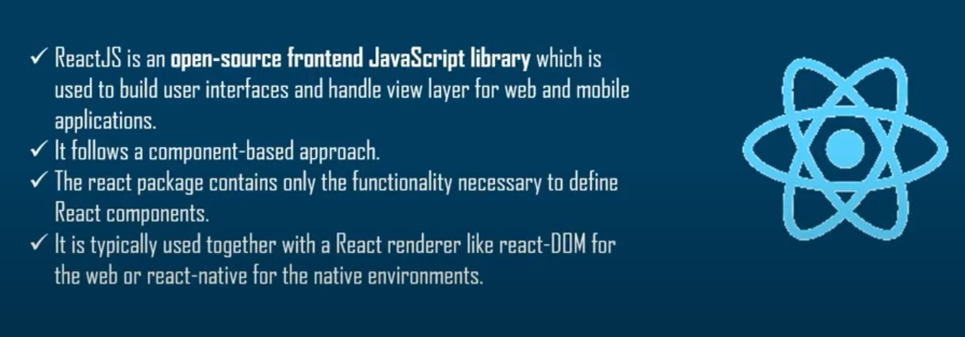
What is ReactJS

Slide 5
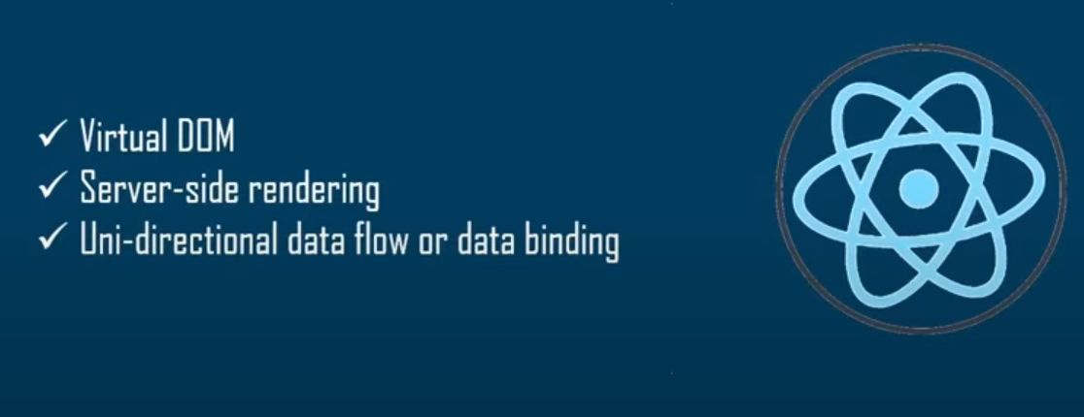
What are the features of ReactJS

Slide 6
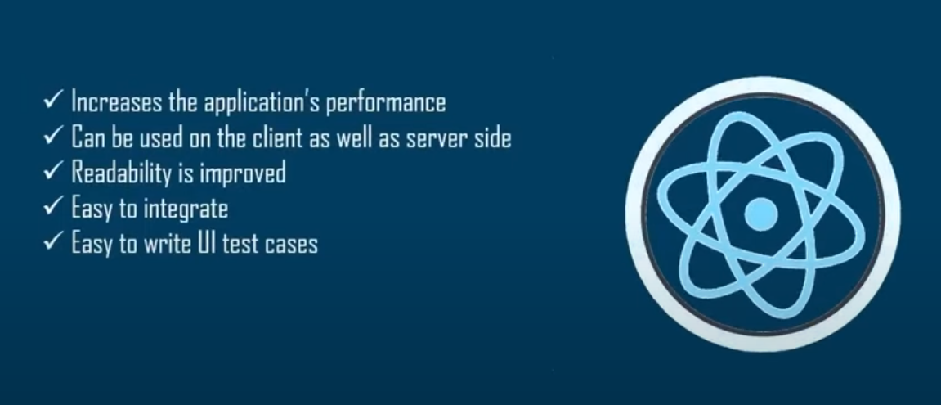
Advantages of ReactJS

Slide 7
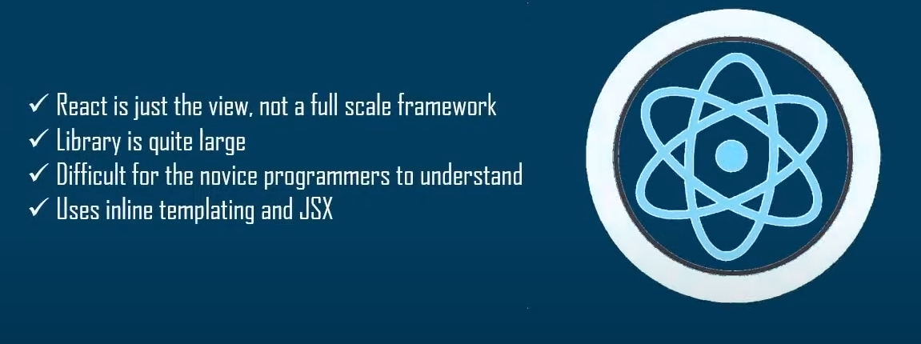
Limitations of ReactJS

Slide 8
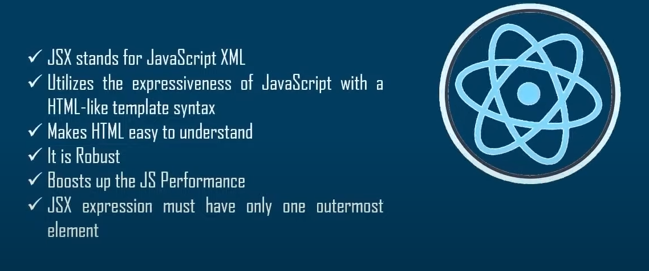
What is JSX

Slide 9
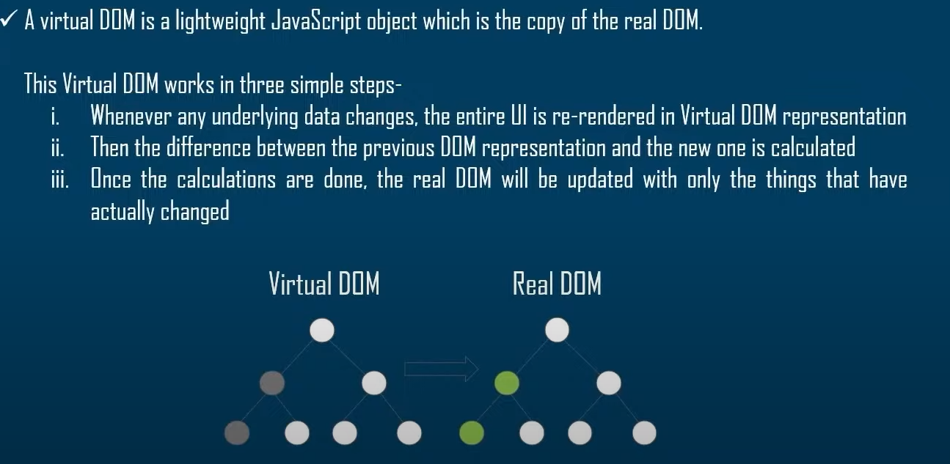
What is Virtual DOM

Slide 10
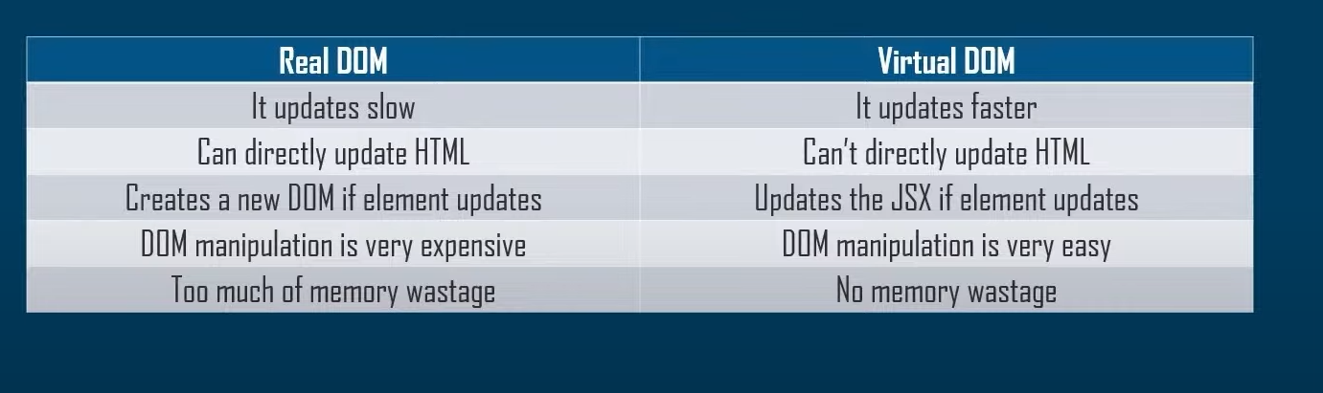
Real DOM Vs Virtual DOM

Slide 11
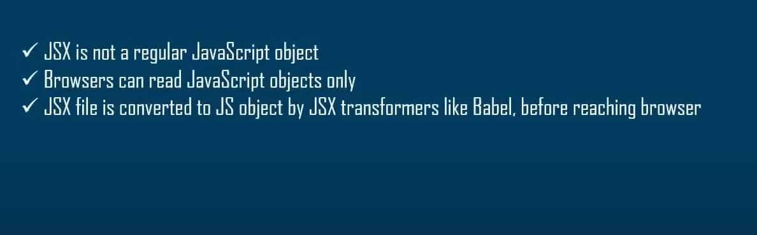
Why cannot browser read JSX

Slide 12
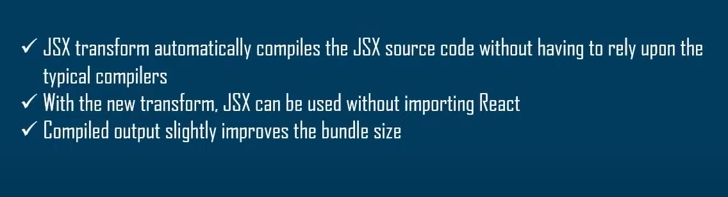
What is JSX transform

Slide 13
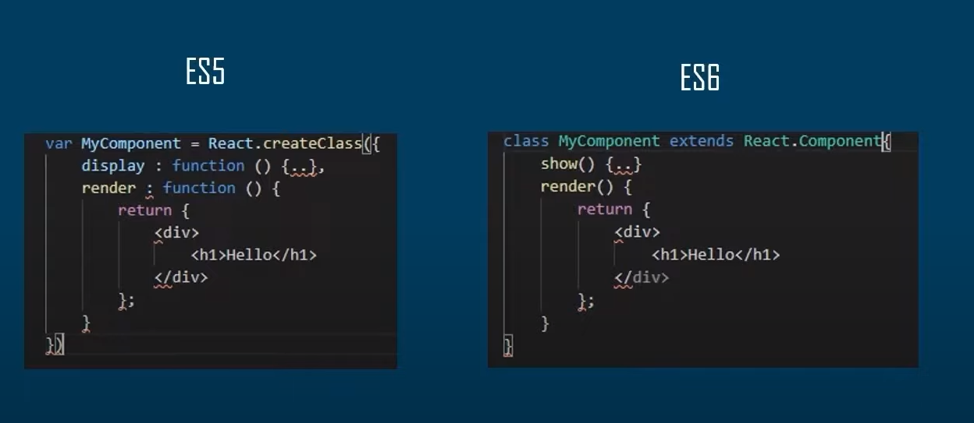
React in ES5 Vs ES6

Slide 14
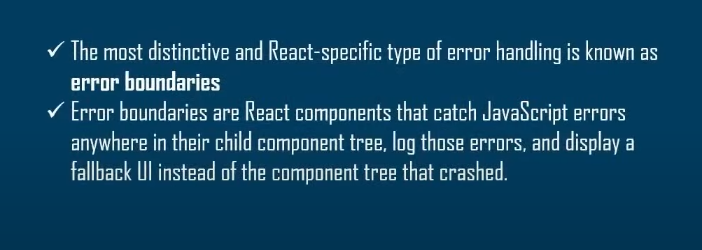
How error is handled in React

Slide 15
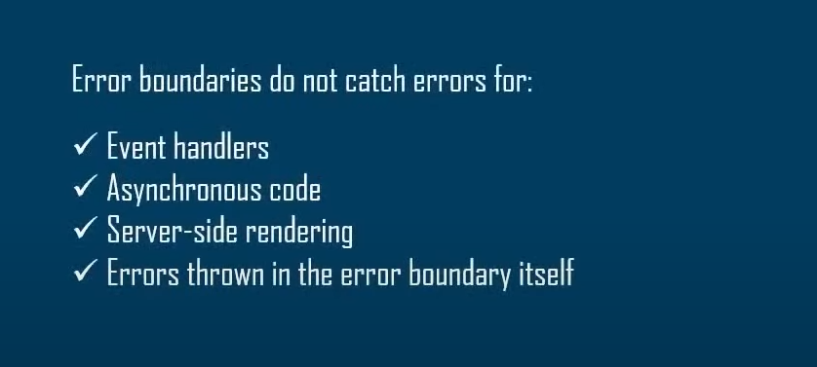
Limitations of error boundaries

Slide 16
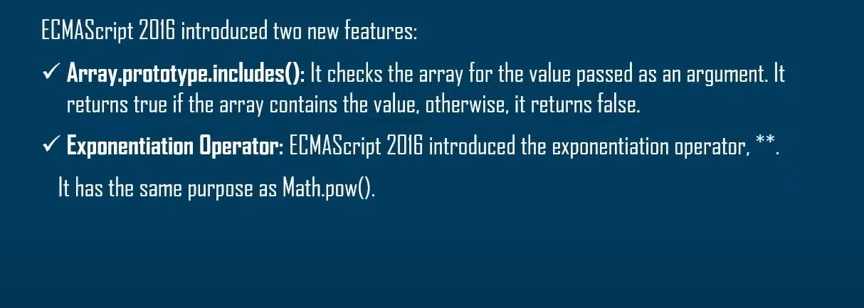
What are the features introduced in ES7

Slide 17
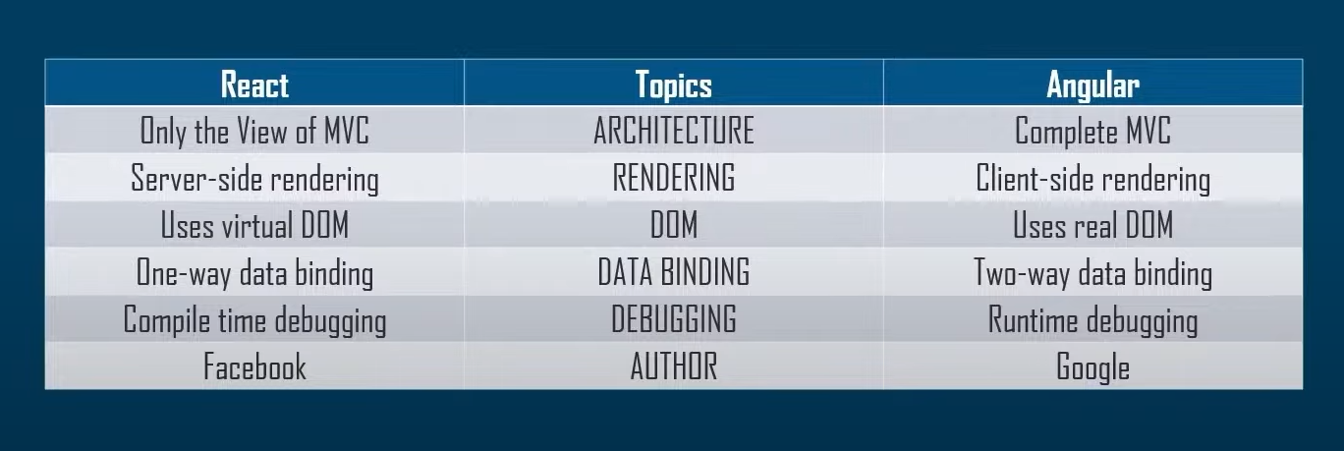
React Vs Angular

Slide 18
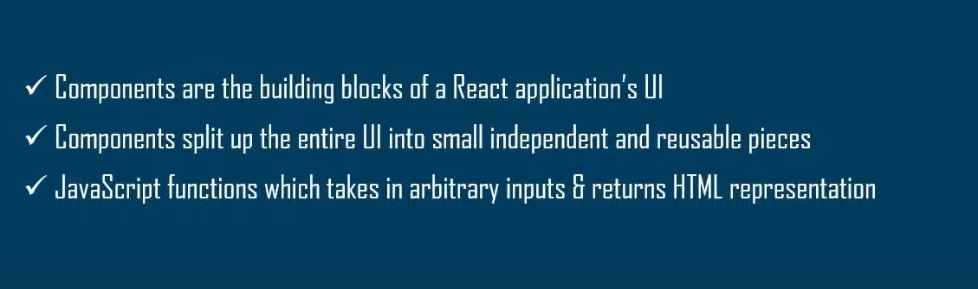
What are components ?

Slide 19
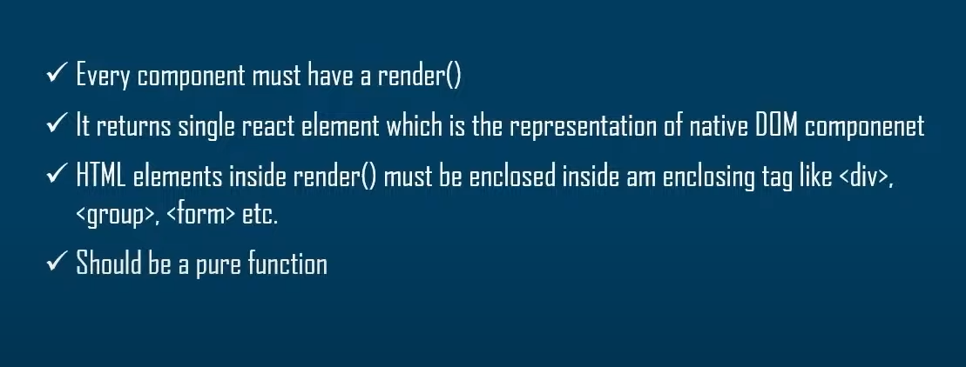
What is the purpose of Render ?

Slide 20
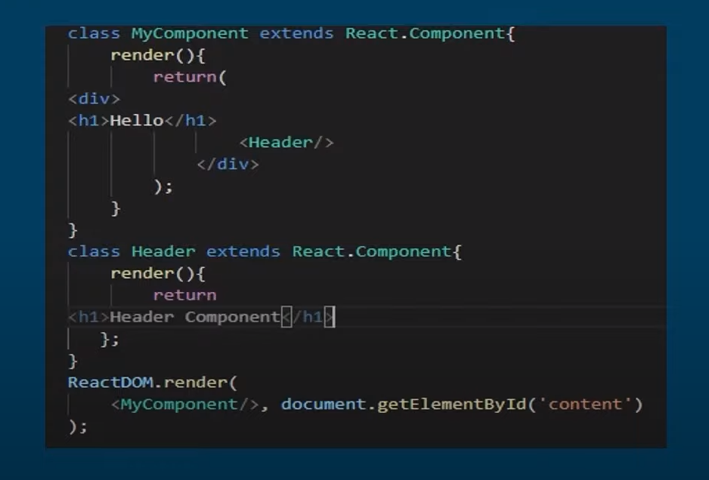
Embedding components

Slide 21
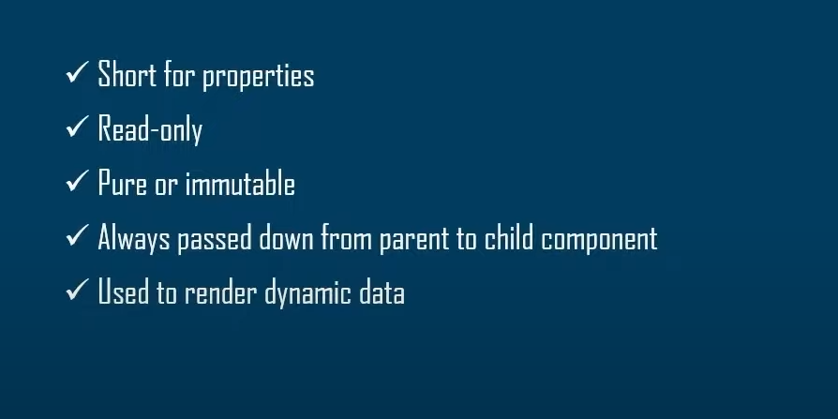
Props in react

Slide 22
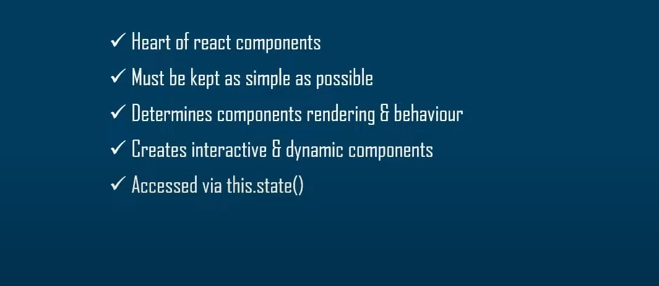
State in react

Slide 23
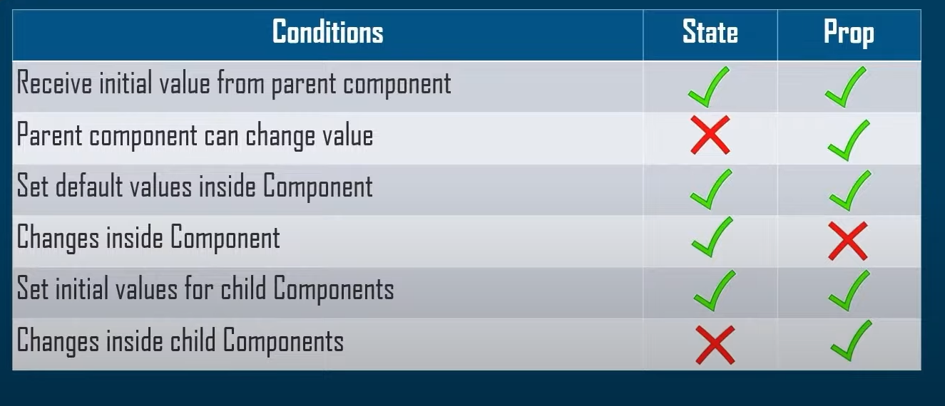
State Vs Props in react

Slide 24
Q&A Session
https://www.youtube.com/watch?v=YpAtOXe9PDs
Thanks

